Slide 1
STUDENT NAME: IMMANUVEL S REGISTER NO:312211618
DEPARTMENT COLLAGE:3A B .COM GENERAL
Employee Data Analysis using Excel

Slide 2
Employee Data Analysis using Excel
project title

Slide 3
AGNEDA
1. Problem Statement
2. Project Overview
3. End Users
4. Our Solution and Proposition
5. Dataset Description 6. Modelling Approach
7. Results and Discussion
8. Conclusion

Slide 4

PROBLEM STATEMENT analysis using Excel involves evaluating and measuring an employee's work effectiveness and efficiency based on key performance indicators (KPIs). This data is then analyzed using Excel's functions and tools, such as pivot tables, charts, and conditional formatting, to identify patterns, strengths, and areas for improvement. The analysis helps in making informed decisions regardinging needs, promotions, and overall workforce optimization.

Slide 5
PROJECT OVERVIEW
The project "Employee Performance Analysis Using Excel aims to Systematically evaluate employee productivity and effectiveness by leveraging Excel's analytical tools. The project will involve collecting and organizing performance data such as task completion rates, accuracy, and attendance records. This data will be processed and analyzed using Excel functions like pivot tables, charts, and statistical formulas to generate insights into individual and team performance. The outcome will help in identifying top performers, recognizing training needs, and making data-driven decisions for performance improvement. The final deliverable will include a detailed report and visual dashboards for easy interpretation and strategic planning.

Slide 6
WHO ARE THE END USERS?
Human Resources (HR) Managers:
Department Managers/Supervisors:
Senior Management/Executives:
Employees:

Slide 7

OUR SOLUTION AND ITS VALUE PROPOSITION
Data-Driven Insights: Enables managers to make informed decisions based on accurate, real-time
performance data.
Improved Efficiency: Automates the data collection and analysis process, saving time and reducing manual
errors.
Enhanced Employee Development: Identifies training needs and development opportunities, leading to a more skilled workforce.
Better Performance Management: Helps in recognizing top performers and addressing. underperformance, ultimately improving overall productivity.
Cost-Effective Solution: Leverages the widely accessible Excel platform, avoiding the need for expensive software or tools.

Slide 8

DATASET DESCRIPTION
Descriptions for each of the columns in the dataset:
1. Employee ID: Unique identifier for each employee in the organization.
2. First Name: The first name of the employee.
3. Last Name: The last name of the employee.
4. Email: The email address associated with the employee's communication within the organization. 5. Business Unit: The specific business unit or department to which the employee belongs.
6. State: The state or region where the employee is located.
7. Job Function: A brief description of the employee's primary job function or role.
8. Gender: A code representing the gender of the employee (e.g. M for Male, F for Female, N for Non-bin
9. Performance Score: A score indicating the employee's performance level (e.g.. Excellent, Satisfactory.
Needs Improvement). 10. Current Employee Rating: The current rating or evaluation of the employee's overall performance

Slide 9

MODELLING
Charts
Purpose: To visualize the data in an easily interpretable format, making trends and
patterns more apparent.
Implementation: Various types of charts (e.g., bar charts, line charts, pie charts) will be created based on the pivot table outputs. For instance, a line chart could show the trend of an employee's productivity over time, while a bar chart could compare performance across different departments.
4. Conditional Formatting
Purpose: To highlight specific data points that meet certain conditions, making t easier to spot trends, outliers, or areas of concern.
Implementation: Conditional formatting will be applied to cells based on rules, such as highlighting cells in red if an employee's performance falls below a certain threshold, or in green if targets are exceeded. This immediate visual cue helps in quickly identifying critical areas needing attention.

Slide 10

MODELLING
In the "Employee Performance Analysis Using Excel" project, the modeling phase involves setting up the Excel workbook with various tools and techniques to analyze and visualize the data effectively. Here's how each component will be used:
1. Data Filtering
Purpose: To sort and refine the data to focus on specific criteria, such as department, date range, or individual employee performance.
Implementation: Excel's filtering feature will be applied to datasets, allowing users to easily narrow down the data to view only the relevant information. For example, filtering by department or by performance rating.
2. Pivot Tables
Purpose: To summarize and analyze large datasets by grouping and aggregating data based on different performance metrics.
Implementation: Pivot tables will be used to dynamically calculate and display key performance indicators (KPIs) such as average task completion time, total hours worked, or percentage of targets met. This will allow users to view performance metrics by different categories, like employee, team, or month.

Slide 11
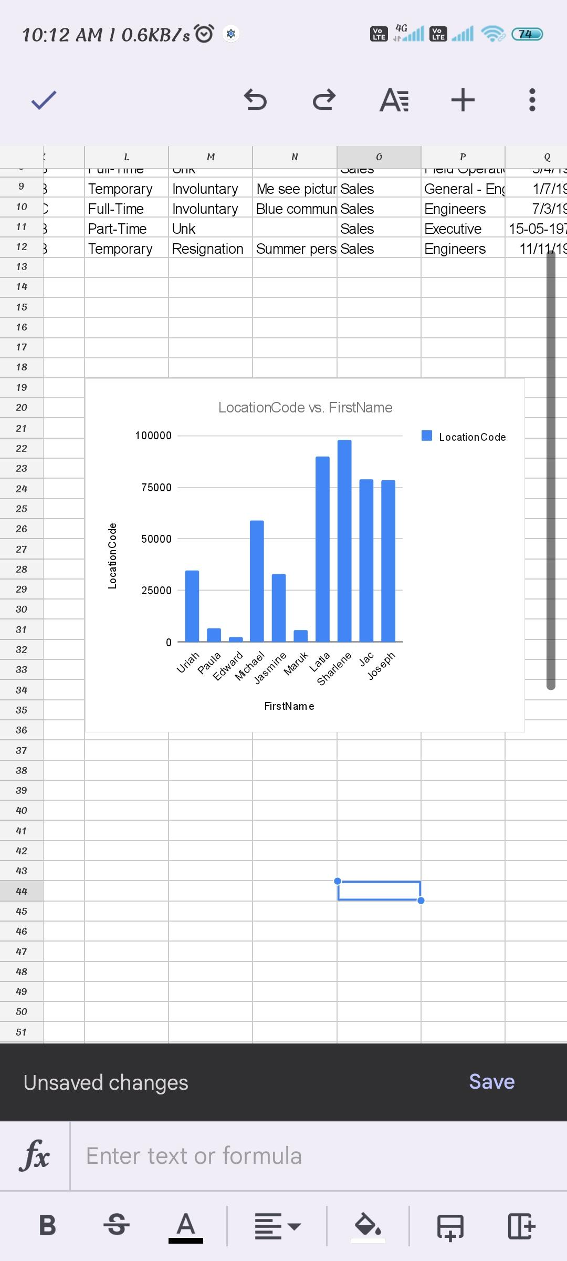
RESULT

Slide 12
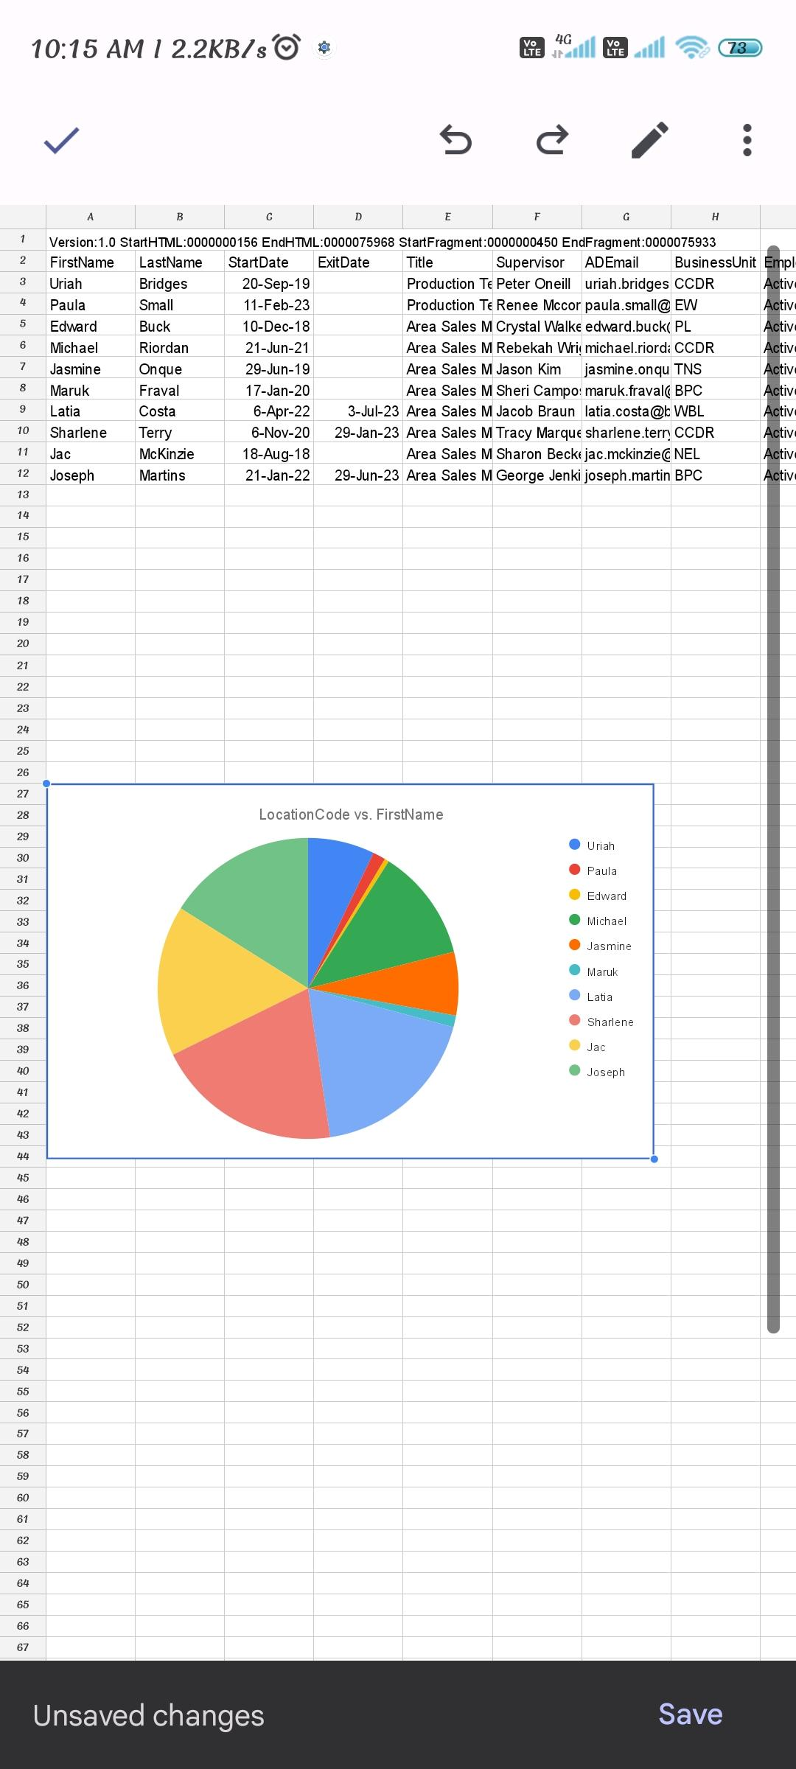
PIECHART

Slide 13
CONCLUSION
The "Employee Performance Analysis Using Excel" project provides a robust and user- friendly solution for evaluating and managing employee performance. By leveraging Excel's powerful tools such as filtering, pivot tables, charts, and conditional formatting-the project transforms raw performance data into actionable insights. The resulting interactive dashboards and customizable reports empower managers to make data-driven decisions, optimize workforce productivity and foster continuous improvement across the organization. This solution not only streamlines performance management but also offers a cost-effective, scalable approach to enhancing overall organizational efficiency.

Slide 14


